Slide 1

CODEWORD

Slide 2
Team members:
Vue.js
Angular:
Naveen Kumar Chandaluri
Sravya Kancharla
Sreelekha Vijaya
Shivani Reddy Dodla
Srimai Reddy Yanala
Vyshnavi Yalamareddy
Naveen Nuggu
Ujjawal Kumar
Anurag Kumar
Chaithanya Cherukuru

Slide 3
Client:
Dr. Charles Hoot
Instructors:
Dr. Denise Case (GDP I)
Dr. Ajay Bandi (GDP II)

Slide 4
Contents:
Problem Statement
Proposed Solution
User description
Codeword criteria
Tools and Technologies
Methodology
Requirements
Demo
Things we have done after mid term
Lessons Learned
Future tasks yet to be accomplished

Slide 5





Problem Statement:
Codeword
Notes:
Codewords are typically used to maintain secrecy and reliability.
About our app:
Codeword is an automated process that issues confidential codewords to each student in a course.
It makes easy for the students while taking up the surveys in beginning and end of the course.
This app maintains anonymity and confidentiality.
Main problem here is, student needs to fill up a survey in the beginning and end of the course. Instructor used to print out the codewords and hand out to the students. There might be a chance of losing the codeword which might end up in not taking the survey at the end of the course. This process also involves tedious work.

Slide 6




Proposed Solution :
Instructor
Students getting Codeword
Students
Notes:
We came up with a solution, where instructor will enter student details and course details into our application. Instructor will also upload excel sheet with the codewords into the system. Students will register and can find the codewords assigned to that particular course. Students can use these codewords for taking up the survey.

Slide 7
User description :
Instructor:
Register as an Instructor
Able to login to the website
Add new course and upload excel sheet with student details and also upload codeword set for each course
Able to upload new codeword set in Codeword set page
Able to edit Course, Student details and codewords
Delete the existing course for students if needed

Slide 8
Student:
Register as a student
Able to login the website
Retrieve the codeword for a selected course
Able to access survey url’s

Slide 9
Codeword criteria:
In the uploaded excel sheet codeword should be unique.
Codeword should be of single word.
Codeword should be of only characters but not numbers or special characters.
Excel sheet should not be empty.
Excel sheet should not have empty cells.

Slide 10





Technologies:
Front - End
Back - End
Http ​
Request
DB Request
DB Response
Http Response
Deployed
Notes:
Here front end is nothing but where user can see ,In front end we are using vue.js and bootstrap.the reason y we are using vue.js is that it is has small size it takes 20kb to download and it has documentation which is useful .Bootstrap has html and css templates where we can refer and use it
In back end is user cannot see we are using node js is an open source and has a documentation where we can refer , easy to download

Slide 11





Tools and Modules:
Notes:
Github is used to create repository and many people can work on the same project at a time
Vss it is a code editor where we can edit the code and run the code and it supports many languages like python ,c#, javascript,css html and has inbuilt git .
Mongodb is used to store data
Postman is used for API calls

Slide 12


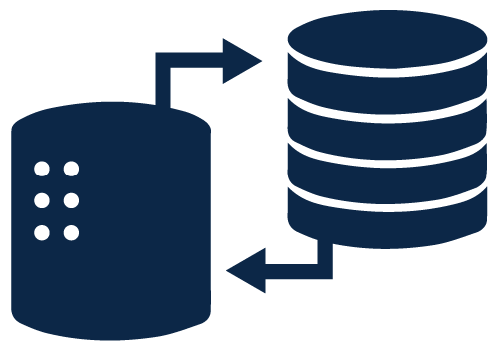


Token Generation
6. Generate token
2. User exists or not
1. Login Request
Front-end
3. User exists
Database
Back-end
4.Password match
8. Send the token
5. Valid Password
7. Store the token

Slide 13
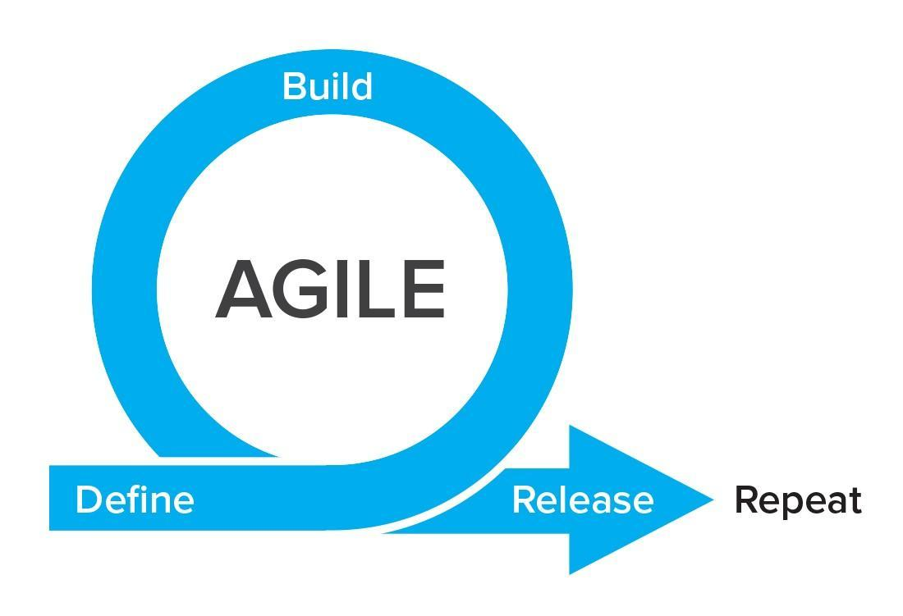
Focus should be more on individuals and interactions instead of processes and tools
Working software is more important that comprehensive documentation
Customer collaboration is more vital than contract negotiation
The process should respond to change rather than follow a plan
Methodology (Agile):
Notes:
Agile is an iterative approach to software delivery that builds software incrementally from the start of the project, instead of trying to deliver it all at once near the end. The projects are broken down into manageable units, making it easier for the team or focus on high-quality development, testing, and collaboration. It is focused client process. So, it makes sure that the client is continuously involved during every stage. Agile methodologies are all about being collaborative, flexible and adaptive. These methodologies are rooted in adaptive planning, delivery and continous improvement all with an eye toward being able to respond to change quickly and easily.

Slide 14
Fisher-Yates algorithm is both elegant in its design and efficient at run-time. Although it looks stunningly simple, this algorithm is unbiased, uses constant memory as it does in-place shuffling, and has optimal linear time efficiency
In pseudo-code, it is simply:
To shuffle an array a of n elements (indices 0..n-1):
for i from n−1 downto 1 do
j ← random integer such that 0 ≤ j ≤ i
exchange a[j] and a[i]
Algorithm (Fisher–Yates shuffle):
Notes:
GIVEN: A collection of items which we want to randomly sort
FIRST: Randomly select one of the "unshuffled" items.
THEN: Swap the selected item with the last item in the collection that has not been selected.
CONTINUE UNTIL: There are no remaining "unshuffled" items.
This algorithm we have used to shuffle the elements in the array.
We are iterating the array of elements from last to first using for loop.
We are generating a random number between the 0 and selected index, and then swaping the element at the selected index with the element at random number.

Slide 15

Requirements
Requirements | Instructor | Student
Able to login
Able to Register
Able to Logout

Slide 16
Instructor Requirements:
Requirements | Instructor
Able to Create Courses
Able to View Courses
Able to delete Courses
Able to Edit the course details

Slide 17
Instructor Requirements:
Able to add the Students
Able to View the students
Able to Edit the Students
Able to delete the Students
Able to Upload new codeword set

Slide 18
Instructor Requirements:
Able to view the codeword set that was uploaded
Able to edit the codewords
Able to delete the codewords
Able to add the new codewords if necessary

Slide 19
Student Requirements:
Requirements | Student
Able to view the courses that they have enrolled
Able to view the codeword corresponding to their course
Able to view the Start and End survey url

Slide 20


Slide 21
Things we have done after mid term:
Added search functionality
Able to search for codeword
Able to search for student
Enabled an option to add student for an existing course
Worked on ‘Acknowledged status’
Added start and end survey URLs on the Student dashboard
Validated the columns in the student details excel sheet
Validated Codewords
Created pagination for the student and codeword tables

Slide 22
Lessons Learned
Team management
Time management
Resource management
Communication management
Quality management
Notes:
Team management: We collaborated with each other while working on the project.
Time: We were able to implement the major functionalities of the project on time because of utilizing the time effectively.
Resource: We divided the tasks based on each and individual skill set
Communication: We communicated effectively via Google docs and other communication media.
Quality: Till the end we all tried our level best in bringing the product as per the requirements of our client.

Slide 23
Lessons Learned (Cont..)
Using Fisher-Yates shuffle algorithm for shuffling the codewords
Using data table module
Used nodemailer to send temporary password
Notes:
Data table module is used for pagination and search functionality

Slide 24


Future tasks yet to be accomplished
Need to complete testing
Need to complete project documentation

Slide 25
Acknowledgements:
We sincerely thank Dr. Hoot for helping us with the project.
We would like to thank Dr. Case and Dr. Bandi for mentoring us to complete the “Codeword” project.

